Slide 1
LCA Methodology
How to do a LCA for a little red COFFEE MACHINE

Slide 2
How to do a LCA?
Phases and applications of an LCA based on ISO 14040.
ISO 14040: Environmental ManagementLife Cycle Assessment Principles and Framework; International Standard Organisation: Geneva, Switzerland, 1997.
(5) ISO 14041: Environmental ManagementLife Cycle Assessment Goal and Scope Definition and Inventory Analysis; International Standard Organisation: Geneva, Switzerland, 1998.
(6) ISO 14042. Environmental ManagementLife Cycle Assessment Life Cycle Impact Assessment; International Standard Organisation: Geneva, Switzerland, 2000.
(7) ISO 14043: Environmental ManagementLife Cycle Assessment Life Cycle Interpretation; International Standard Organisation: Geneva,Switzerland, 2000.(8) ISO 14040: Environmental ManagementLife Cycle Assessment Principles and Framework; International Standard Organisation: Geneva, Switzerland, 2006.
(9) ISO 14044: Environmental Management - Life Cycle Assessment - Requirements and Guidelines; International Standard Organisation: Geneva, Switzerland, 2006.

Slide 3
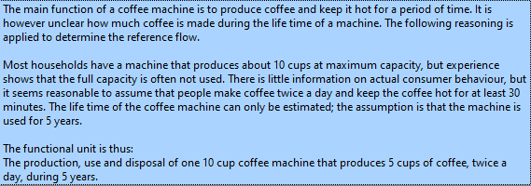
Life Cycle Assessment of a Coffee Machine

Slide 4
LCA methodology - working step by step
Definition of a functional unit
Inventory analysis
Process chart
Classification
Charakterization
Normalization
Weighting
Interpretation
Data Base: SimaPro5

Slide 5
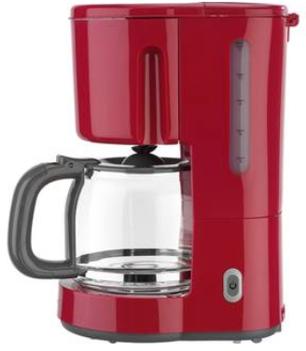
Goal and Scope of this Analysis A simple Coffee Machine Production, Use and End of Live
Definition of a functional unit

Slide 6
2. Inventory Analysis - Sorts of Materials
Feather out of Aluminium
Glass Can
Corpus & Hold of the Coffee Machine is based on Polystyrene Plastic
Ring & Heating Plate out of Steel (Iron)
Coffee Filter out of Paper

Slide 7
2. Inventory Analysis - Weigt of Materials
Feather out of Aluminium
0.1 kg
Glass Can
0.4 kg
Corpus & Hold of the Coffee Machine is based on Polystyrene Plastic
1 kg
Ring & Heating Plate out of Steel (Iron)
Coffee Filter out of Paper
0.3 kg
7.3 kg

Slide 8
2. Inventory Analysis - Production Processes
Feather out of Aluminium
0.1 kg
Extrusion
Glass Can
0.4 kg
Forming
Corpus & Hold of the Coffee Machine is based on Polystyrene Plastic
1 kg
Injection moulding
Ring & Heating Plate out of Steel (Iron)
Coffee Filter out of Paper
0.3 kg
Pressing
7.3 kg
Filter production

Slide 9
3. Process Chart - Production Process with SimaPro5 DEMO Version
Polystyrene
Glass
Steel (Iron)
Aluminium
Paper
1 kg
0.4 kg
0.3 kg
0.1 kg
7.3 kg
Injection moulding
Forming
Pressing
Extrusion
Filter production
Assembly & Transport
Electricity low-voltage
USE
Disposal of coffee machine

Slide 10
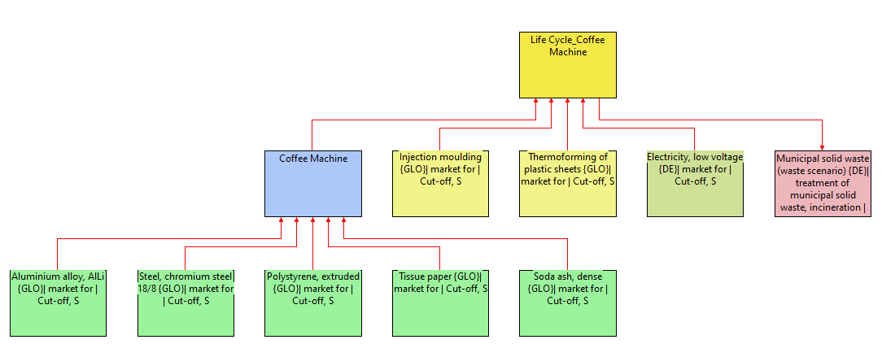
SANKEY DIAGRAMM
Life Cycle Assessment „Coffee Machine“
Software Tool SimaPro5, Demo Version Education Classroom
Method „Eco Indicator 99 (H) V2.10 / Europe EI 99

Slide 11
8. Interpretation Data Base: SimaPro5

Slide 12
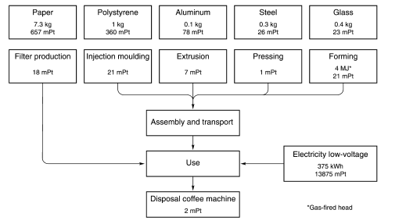
3. Inventory Analysis - A simplified process chart for the life cycle of a coffee machine.

Slide 13
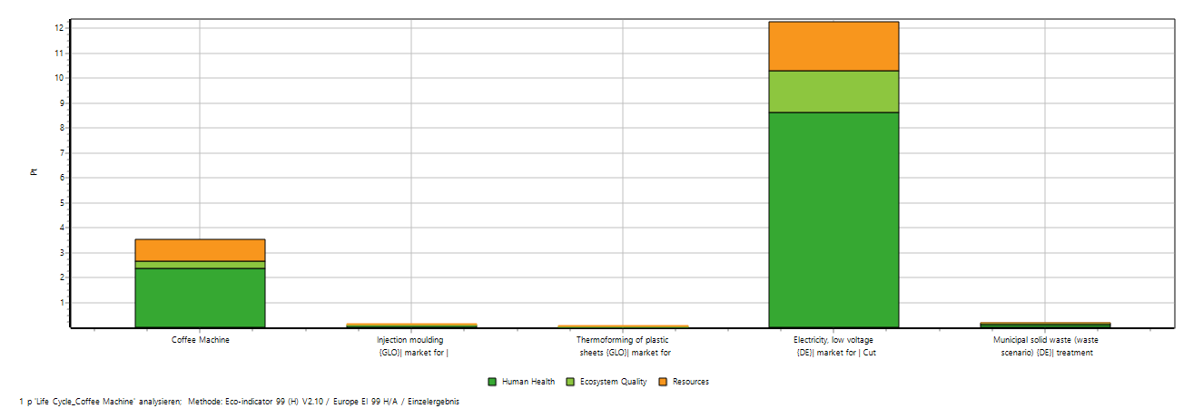
8. Interpretation Data Base: SimaPro5

